Slide 1
Unit – II
MY SQL DATABASE PROGRAMMING
Connecting – Table Creation – Record Insertion – Updation – Multiple Database Handling.
Open Source Programming
1

Slide 2
My SQL - Introduction
SQL (Structured Query Language) database server.
licensed with the GNU General public license http://www.gnu.org/
MySQL is a database management system.
MySQL is a relational database management system.
MySQL is Open Source Software
Open Source Programming

Slide 3
Advantages
Advantages:
very fast
reliable and easy to use
robust SQL database server.
Open Source Programming

Slide 4
Types of Commands
Data Definition Language (DDL)
  Commands that define a database, including creating, altering, and dropping tables and establishing constraints.
Data Manipulation Language (DML)
  Commands that send query to a database like add new records, delete records, update the records and select the records.
Data Control Language (DCL)
  Commands that control a database, including administering privileges and committing data.
Open Source Programming

Slide 5
My SQL Commands
Data Definition Language (DDL):
  ▪ Create ▪ Drop
  ▪ Alter
Data Manipulation Language (DML):
  ▪ Select ▪ Update
  ▪ Insert ▪ Delete
Data Control Language (DCL):
  ▪ Grant ▪ Revoke
Open Source Programming

Slide 6
Basic MySQL Process
Database process
CREATE DATABASE databaseName;
DROP DATABASE databaseName;
SHOW DATABASES;
USE databaseName;
DDL processs:
SHOW TABLES;
DESCRIBE table;
CREATE TABLE tableName(name1 type1, name2 type2, ...);
ALTER TABLE tableName add/modify fieldname type,……;
DROP TABLE tableName;
DML Process:
INSERT INTO TABLE VALUES( value1, value2, ...);
SELECT field1, field2, ... FROM tableName;
UPDATE TABLE tablename SET field = exp/val [where condition];
DELETE FROM tablename [where condition];
Open Source Programming

Slide 7
Basic MySQL PHP functions
  mysql_connect() – creates a connection
  mysql_close() – closes the connection
  mysql_select_db() – selects the database
  mysql_query() – Executes MySQL queries
  mysql_error() – returns the error
  mysql_num_rows() – Retrieves the number of rows from a result set.
mysql_num_fields () - Retrieves the number of
fields from a query.
Open Source Programming

Slide 8
Basic MySQL PHP functions
mysql_affected_rows() – returns the no. of affected rows
mysql_fetch_row () - returns a numerical array that corresponds to the fetched row. Returns FALSE if
there are no more rows.
mysql_fetch_array() - returns a row from a recordset as an associative array / numeric array.
mysql_fetch_assoc() - returns a row from a recordset as an associative array.
mysql_fetch_field() - returns an object containing information of a field from a recordset.
Open Source Programming

Slide 9
Basic MySQL PHP functions
get_resource_type () - gets the type of the given resource(not mysql function)
mysql_get_client_info() returns a string that represents the client library version.
mysql_get_server_info() - Retrieves the MySQL server version.
mysql_pconnect() — Open a persistent connection to a MySQL server
mysql_free_result() — Free result memory
mysql_list_dbs() — Lists all databases.
Open Source Programming

Slide 10
MySQL - Connect
Create Connection:
Before accessing data in a database, we must create a connection to the database. In PHP, this is done with the mysql_connect() function.
mysqli_connect(servername,username,password);
E.g:
<?php
$con = mysql_connect("localhost",“root","admin");
if (!$con)
{
die('Could not connect: ' . mysql_error());
}
?>
Open Source Programming

Slide 11
My SQL - Close
Close Connection:
The connection will be closed automatically when the script ends. To close the connection before, use the mysql_close() function:
mysqli_close($con);
<?php
$con = mysql_connect("localhost",“root","admin");
if (!$con)
{
die('Could not connect: ' . mysql_error());
}
//some code
mysql_close($con);
?>
E.g:
Open Source Programming

Slide 12
My SQL – Select DB
Database selection can be done by this function.
mysqli_select_db($con,$dbname);
E.g:
<?php
mysql_connect("localhost", "root", “admin") or die(mysql_error());
echo "Connection to the server was successful!<br/>";
mysql_select_db("sample") or die(mysql_error());
echo "Database was selected!<br/>";
?>
Open Source Programming

Slide 13
My SQL – Query
All DDL & DML queries can be executed by this function.
mysqli_query($con, $query);
E.g: Create DB
<?php
mysql_connect("localhost", "root", “admin") or die(mysql_error());
if (mysql_query(" CREATE DATABASE sample if not exists",$con))
echo "Database created";
else
echo "Error creating database: " . mysql_error();
mysql_close($con);
?>
Open Source Programming

Slide 14
My SQL – Query
E.g: Drop DB
<?php
mysql_connect("localhost", "root", “admin") or die(mysql_error());
$dbname=“sample”;
if (mysql_query(“DROP DATABASE “.$dbname,$con))
echo "Database dropped";
else
echo "Error in dropping database: " . mysql_error();
mysql_close($con);
?>
Open Source Programming

Slide 15
My SQL – Query
E.g: create Table
<?php
mysql_connect("localhost", "root", “admin") or die(mysql_error());
$db = mysql_select_db(“sample”,$con);
$query = “create table mytable ( id int(3), name varchar(20), desc1 varchar(20), primary key(id))”;
If ( mysql_query($query, $con))
echo “mytable was created”;
Else
echo “error “.mysql_error();
mysql_close($con);
?>
Open Source Programming

Slide 16
My SQL – Query
E.g: Alter Table
<?php
$con = mysql_connect("localhost","root",“admin") or die('Could not connect: ' . mysql_error());
mysql_select_db(“sample”,$con);
$query =“alter table mytable (add column age int(2), drop column desc1, modify column name varchar(30))”;
if (mysql_query($query,,$con))
echo “Table altered";
else
echo "Error in alteration: " . mysql_error();
mysql_close($con);
?>
Open Source Programming

Slide 17
My SQL – Query
E.g: Drop table
<?php
$con = mysql_connect("localhost","root",“admin") or die('Could not connect: ' . mysql_error());
$db = mysql_select_db(“sample”,$con);
$query = “drop table mytable”;
If ( mysql_query($query, $con))
echo “table dropped”;
Else
echo “error “.mysql_error();
mysql_close($con);
?>
Open Source Programming

Slide 18
My SQL – Query
E.g: Insert record
<?php
$con = mysql_connect("localhost","root",“admin") or die('Could not connect: ' . mysql_error());
$db = mysql_select_db(“sample”,$con);
$pid = $_POST[‘fid’];
$pname = $_POST[‘fname’];
$query = “insert into mytable values($pid,’$pname’)”;
If ( mysql_query($query, $con))
echo “record inserted”;
Else
echo “error “.mysql_error();
mysql_close($con);
?>
Open Source Programming

Slide 19
My SQL – Query
E.g: Delete record
<?php
$con = mysql_connect("localhost","root",“admin") or die('Could not connect: ' . mysql_error());
$db = mysql_select_db(“sample”,$con);
$pid = $_POST[‘fid’];
$query = “delete from mytable where id = $pid”;
If ( mysql_query($query, $con))
echo “record deleted”;
Else
echo “error “.mysql_error();
mysql_close($con);
?>
Open Source Programming

Slide 20
My SQL – Query
E.g: update table
<?php
$con = mysql_connect("localhost","root",“admin") or
die('Could not connect: ' . mysql_error());
$db = mysql_select_db(“sample”,$con);
$query = “update table mytable set id = 11 where name = \”John\” ”;
If ( mysql_query($query, $con))
echo “record updated”;
Else
echo “error “. mysql_error();
mysql_close($con);
?>
Open Source Programming

Slide 21
My SQL – Query
E.g: select from table
<?php
$con = mysql_connect("localhost","root",“admin") or
die('Could not connect: ' . mysql_error());
$db = mysql_select_db(“sample”,$con);
$query = “select * from mytable”;
$selected_recs = mysql_query($query, $con))
mysql_close($con);
?>
Open Source Programming

Slide 22
My SQL – Error
Mysql_error() – describes the error for the last MySQL process.
E.g:
<?php
$con = mysql_connect("localhost","root",“admin“)// or
// die('Could not connect: ' . mysql_error());
$db = mysql_select_db(“wrongdb”,$con);
If ( ! $db)
{
echo “error – mysql_error()”;
}
mysql_close($con);
?>
Open Source Programming

Slide 23
My SQL – num_rows
Mysqli_num_rows(result) – Retrieves the number of rows from a result set.
This command is only valid for statements like SELECT or SHOW that return an actual result set. (db6.php)
E.g:
<?php
$link = mysql_connect("localhost", "root", “admin");
mysql_select_db(“sample", $link);
$result = mysql_query("SELECT * FROM mytable", $link);
$num_rows = mysql_num_rows($result);
echo "$num_rows Rows were selected";
?>
Open Source Programming

Slide 24
My SQL – num_fields
Mysql_num_fields() – Retrieves the number of fields from a result set. (db6.php)
E.g:
<?php
$link = mysql_connect("localhost", "root", “admin");
mysql_select_db(“sample", $link);
$result = mysql_query("SELECT * FROM mytable", $link);
$num_fields = mysql_num_fields($result);
echo "$num_fields Fields were selected";
?>
Open Source Programming

Slide 25
My SQL – affected_rows
Mysqli_affected_rows() – Returns the number of rows in a result set on success or FALSE on failure. It is valid for insert, delete, and update commands only.
mysql_affected_rows($recordset);
E.g:
<?php
$con = mysql_connect("localhost","root",“admin") or
die('Could not connect: ' . mysql_error());
$db = mysql_select_db(“sample”,$con);
$query = “update table mytable set id = 11 where name = \”John\” ”;
$result = Mysql_query($query,$con);
$num_rows = mysql_affected_rows($result);
echo "$num_rows Rows were selected";
mysql_close($con);
?>
Open Source Programming

Slide 26
My SQL – fetch_row
mysql_fetch_row () - returns a numerical array that corresponds to the fetched row. Returns FALSE if there are no more rows.
mysql_fetch_row($recordset);
E.g:
<?php
$con = mysql_connect("localhost", "root", “admin") or die(“error”);
$db_selected = mysql_select_db("test",$con);
$result = mysql_query("SELECT * from mytable",$con);
while ($r1 =mysql_fetch_row($result))
echo $r1[0], $r1[1]; // table has 2 fields only
mysql_close($con);
?>
Open Source Programming

Slide 27
My SQL – fetch_array
Extended version of mysql_fetch_row. Returns an numeric/associative array that corresponds to the fetched row and moves the internal data pointer ahead or FALSE if there are no more rows.
mysql_fetch_array($recordset);
E.g:
<?php
$con = mysql_connect("localhost", "root", “admin") or die(“error”);
$db_selected = mysql_select_db("test",$con);
$result = mysql_query("SELECT * from student",$con);
while ($row=mysql_fetch_array($result))
print_r($row); // prints rec as numeric & associative array
mysql_close($con);
?>
Open Source Programming

Slide 28
My SQL – fetch_assoc
Returns an associative array that corresponds to the fetched row and moves the internal data pointer ahead or FALSE if there are no more rows. Here, field names are array keys .
mysql_fetch_assoc($recordset);
E.g:
<?php
$con = mysql_connect("localhost", "root", “admin") or die(“error”);
$db_selected = mysql_select_db("test",$con);
$result = mysql_query("SELECT * from student",$con);
while ($row=mysql_fetch_assoc($result))
print_r($row); // prints rec as associative array
mysql_close($con);
?>
Open Source Programming

Slide 29
My SQL – fetch_field
Returns an object containing field information. This function can be used to obtain information about fields in the provided query result.(All in db6.php)
msql_fetch_field($recordset);
The properties of the object are:
name - column name
table - name of the table the column belongs to
max_length - maximum length of the column
not_null - 1 if the column cannot be NULL
primary_key - 1 if the column is a primary key
unique_key - 1 if the column is a unique key
multiple_key - 1 if the column is a non-unique key
numeric - 1 if the column is numeric
blob - 1 if the column is a BLOB
type - the type of the column
unsigned - 1 if the column is unsigned
zerofill - 1 if the column is zero-filled
Open Source Programming

Slide 30
E.g:
<?php
$con = mysql_connect("localhost", "root", “admin") or die(mysql_error());
$db_selected = mysql_select_db("suresh",$con);
$result = mysql_query("SELECT * from emp",$con);
while ($property = mysql_fetch_field($result))
{ echo "Field name: " . $property->name . "<br />";
echo "Table name: " . $property->table . "<br />";
echo "Default value: " . $property->def . "<br />";
echo "Max length: " . $property->max_length . "<br />";
echo "Not NULL: " . $property->not_null . "<br />";
echo "Primary Key: " . $property->primary_key . "<br />";
echo "Unique Key: " . $property->unique_key . "<br />";
echo "Mutliple Key: " . $property->multiple_key . "<br />";
echo "Numeric Field: " . $property->numeric . "<br />";
echo "BLOB: " . $property->blob . "<br />";
echo "Field Type: " . $property->type . "<br />";
echo "Unsigned: " . $property->unsigned . "<br />";
echo "Zero-filled: " . $property->zerofill . "<br /><br />";
}?>
Open Source Programming

Slide 31
My SQL – get_client_info
mysql_get_client_info() returns a string that represents the client library version.
mysql_get_client_info();
E.g:
<?php
echo "MySQL client info: " . mysql_get_client_info();
?>
Open Source Programming

Slide 32
My SQL – get_server_info
mysql_get_server_info() returns a string that represents the server version.
mysql_get_server_info();
E.g:
<?php
echo "MySQL server info: " . mysql_get_server_info();
?>
Open Source Programming

Slide 33
My SQL – free_result
Clears the record set.
mysql_free_result($recordset);
E.g:
<?php
$con = mysql_connect("localhost", "root", “admin") or die(“error”);
$db_selected = mysql_select_db("test",$con);
$result = mysql_query("SELECT * from student",$con);
print_r($row=mysql_fetch_row($result));
mysql_free_result($result);
print_r($row=mysql_fetch_row($result)); // shows error
mysql_close($con);
?>
Open Source Programming

Slide 34
My SQL – Pconnect
Establishes a persistent connection to a MySQL server like mysql_connect with two major differences.
mysql_pconnect($recordset);
First, when connecting, the function would first try to find a (persistent) link that's already open with the same host, username and password. If one is found, an identifier for it will be returned instead of opening a new connection.
Second, the connection to the SQL server will not be closed when the execution of the script ends. Instead, the link will remain open for future use (mysql_close() will not close links established by mysql_pconnect()).
Open Source Programming

Slide 35
My SQL – Pconnect
E.g:
<?php
$con = mysql_pconnect("localhost","root",“admin") or die(mysql_error());
echo "A persistent connection was established";
mysql_close($con);
mysql_select_db("test", $con) or die("Connection closed");
$result = mysql_query("SELECT * FROM mytable", $con);
$num_rows = mysql_num_rows($result);
echo "$num_rows Rows\n";
?>
GIVES Output since it is a persistent connection
Open Source Programming

Slide 36
My SQL – list_dbs
Returns all databases available on mysql server.
mysql_list_dbs($con);
E.g:
<?php
$con = mysql_connect("localhost", “root", “admin") or die(mysql_error);
$db_list = mysql_list_dbs($con);
while ($db = mysql_fetch_object($db_list))
{
echo $db->Database . "<br />";
}
mysql_close($con);
?>
Open Source Programming

Slide 37
get_resource_type
This function used to get the type of resource.
get_resource_type($resource);
E.g:
<?php
// prints: mysql link
$c = mysql_connect("localhost", "root", “admin");
echo $c;
echo get_resource_type($c) . "<br>";
// prints: file
$fp = fopen("foo", "w");
echo $fp;
echo get_resource_type($fp) ;
?>
Open Source Programming

Slide 38
My SQL – Multiple DataBases
Multiple databases can be used at a time. The following example program explains it.
E.g:
<?php
$con = mysql_connect(“localhost”,”root”,”admin”);
$db1 = mysql_select_db("database1", $con);
$db2 = mysql_select_db("database2", $con);
$result1 = mysql_query(“select * from mytable", $db1);
$result2 = mysql_query(“select * from table3”, $db2);
?>
Open Source Programming

Slide 39
List the databases
This program lists all databases names
<?php
$con = mysql_connect("localhost", "root", "") or die(mysql_error());
$query="show databases";
$dbset=mysql_query($query) or die(mysql_error());
echo "<h1>List of data bases</h1><br>";
while($db=mysql_fetch_assoc($dbset))
{
echo $db['Database'];
echo "<br>";
}
mysql_close($con);
?>
Open Source Programming

Slide 40
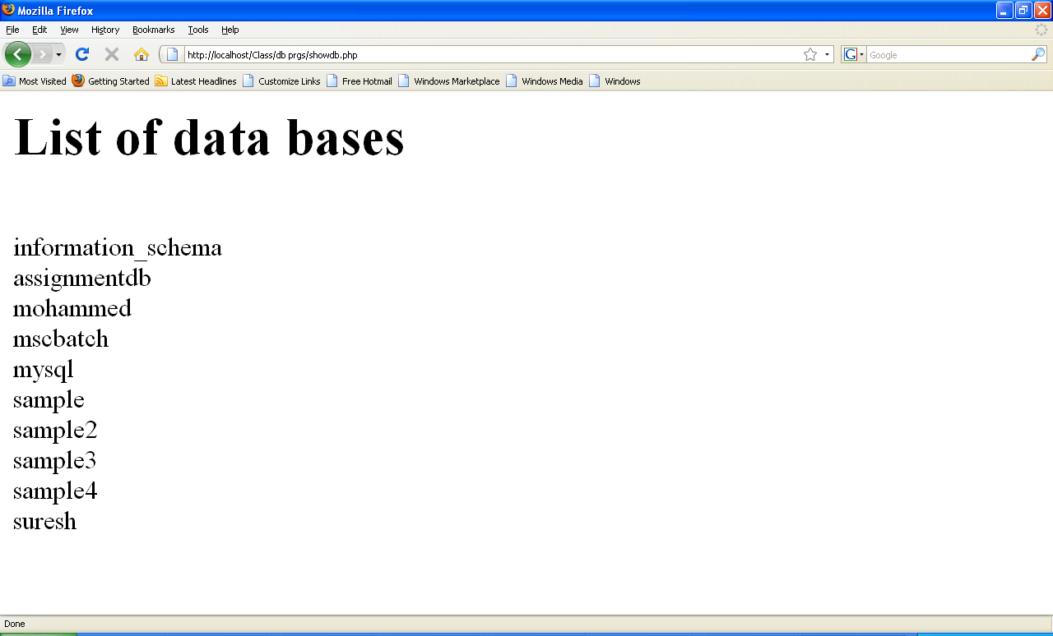
Output
Open Source Programming

Slide 41
List the Fields with properties
This program lists all fields of mytab
<?php
$con=mysql_connect("localhost","root","");
mysql_select_db("sample",$con);
$result = mysql_query("SHOW COLUMNS FROM mytab",$con) or die(mysql_error());
echo "<centre><h1> Fields of Mytab</h1> </centre><br>";
while ($row = mysql_fetch_assoc($result))
{
print_r($row);
echo "<br>";
}
?>
Open Source Programming

Slide 42
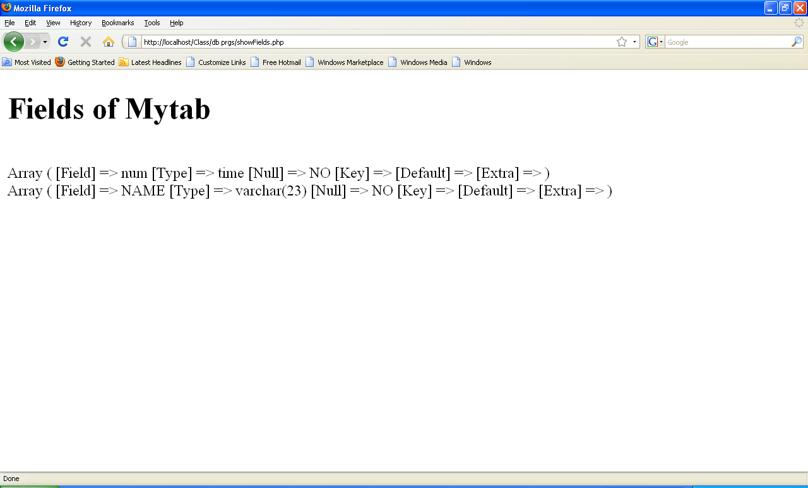
Output
Open Source Programming

Slide 43
Unit-II
Ends
Open Source Programming

